Slide 1
Prisoner Data Analysis and Visualisation
Jack Gilmore

Slide 2
The brief
“You are required to develop a Python application that processes prisoner data, provides a REST API for accessing the data, and displays the data as interactive charts in a web browser.”

Slide 3
Milestones
Data Processing and Analysis
Front-End Development
Security and Best Practices
Deployment (stretch goal)
API Development

Slide 4
Timeline
07/06/2024
Initial invite with brief
10/06/2024 Received updated deadline
19/06/2024 New deadline
01/07/2024 Original deadline

Slide 5
Research
Scottish Prison Population Statistics 2022-23
https://www.gov.scot/publications/scottish-prison-population-statistics-2022-23/
Scottish Prisons Interactive Analysis Tool Shiny App
https://scotland.shinyapps.io/sg-prison-population-statistics/
Scottish prison population statistics technical manual
https://www.gov.scot/publications/scottish-prison-population-statistics/
Scottish Government Design System
https://designsystem.gov.scot/

Slide 6
Strategy
Task management
Minimum Viable Product
Clear acceptance criteria
Architectural decisions
In a real-life scenario, constant feedback is beneficial

Slide 7
Architectural decision review
Option 1: MySQL
Pros:
Mature and widely used, especially in web applications.
Good support for transactions and complex queries.
Scalability for large datasets and high traffic.
Cons:
Requires setup and maintenance of a separate infrastructure.
May be overkill for smaller applications?
Option 2: SQLite ✅
Pros:
Serverless and self-contained; no separate server setup needed.
Simple to deploy and manage; ideal for small to medium applications.
Good performance for read-heavy operations.
Cons:
Limited concurrency compared to client-server databases like MySQL.
Less suitable for write-heavy applications or large datasets.
Lack of advanced features like stored procedures and user management.

Slide 8
Execution - database
prisoner_id | name | age | gender | crime | sentence_years | prison
integer | string | integer | character | string | integer | string
1 | John Doe | 34 | M | Murder | 25 | Barnard Castle
2 | Jane Smith | 29 | F | Theft | 5 | Edinburgh
3 | Bob Johnson | 42 | M | Fraud | 10 | Glasgow

Slide 9
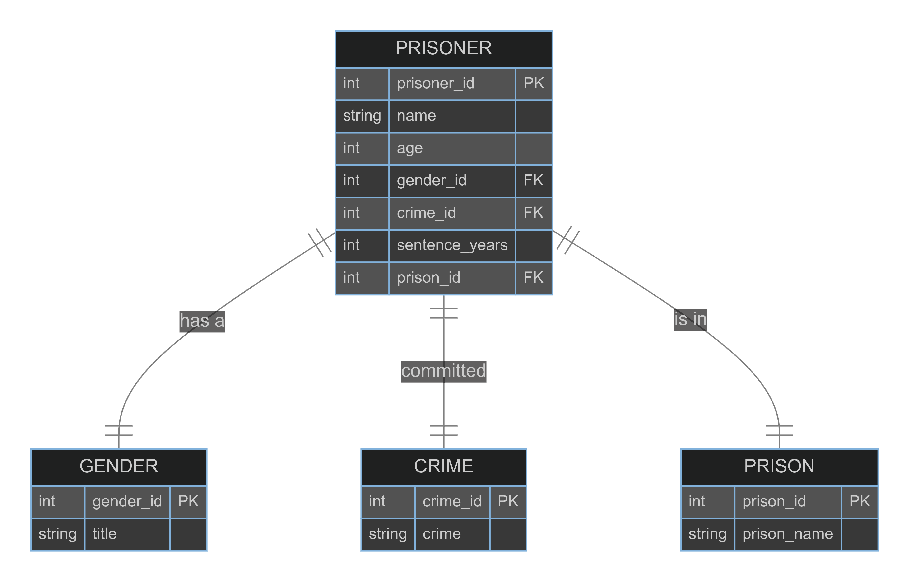
Execution - database

Slide 10
Execution
Load data and analyse
load_data.py (PyMuPDF)
analysis.py (Pandas)
API development
database.py (SQLAlchemy)
main.py (Fast API)
Front-End development
index.html
chart.js
database.py (SQLAlchemy)
custom-charts.js
Swagger

Slide 11
Security considerations
Storage of data at rest
Database authentication
API authentication
Input validation and sanitisation
Access control – code and app
Auditing

Slide 12
Lessons learned
FastAPI – routing ordering matters with static files
Implement stronger test suite to identify regressions
SQLite – Foreign keys not enforced by default
Trust ORMs, but don’t rely on defaults and consult documentation

Slide 13
What would I do if I had more time?
JS and CSS package management via NPM
Bundle and minify assets
Extend tests
Database integration tests
Model function tests
System tests in the web browser
More validation and checks on data load

Slide 14
What would I in a real production scenario?
Centralised or more sophisticated API authentication
Database infrastructure
Dev / Test / UAT / Staging environments
Statistical anonymisation
Monitoring, alerting and analytics
Infrastructure as code – aids with disaster recovery

Slide 15
Questions?

